Slide 1
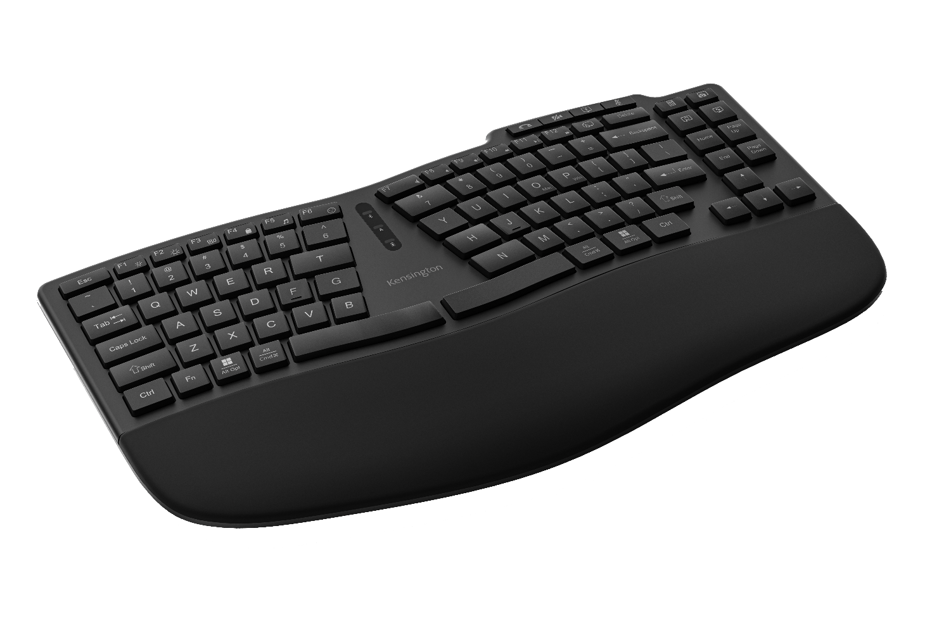
Pro Fit® Ergo KB675 EQ TKL Rechargeable Keyboard
Ergonomic Design The thoughtfully designed compact curved key layout, built-in wrist pad, and front keyboard legs support optimal hand and wrist positioning for all-day ergonomic comfort and productivity.
Multiple Connection Options Supports up to three devices - two via Bluetooth® connections, one via the 2.4GHz USB receiver with 128-bit AES government-grade encryption security.
Swift Pair Technology Enhanced Bluetooth® connection technology designed to reduce pairing hassles and simplify connections for Windows devices.
Productivity Enhancing Keys and Lights Video conferencing keys support efficient meeting transitions. Vibrant RGB indicators allow you to easily monitor your connection status, caps lock, and battery life.
Long-Lasting Power The built-in 500mAh rechargeable battery includes a convenient USB-C® charging port and cable for uninterrupted productivity.
Customizable Keys Customize your experience by programming keys, creating macros, adjusting key mappings, managing profiles, and more with the optional Kensington Konnect™ software.
Sustainability Focused Aimed at reducing our environmental impact, the outer casing and keycaps are composed of 65% post-consumer recycled content (PCR).
K75491US

